Slide 1
Features Extraction

Slide 2
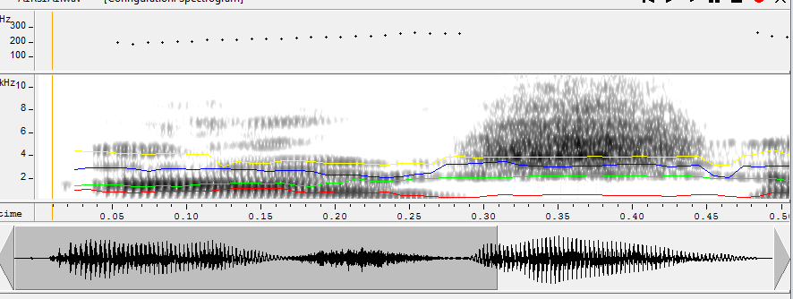

Slide 3
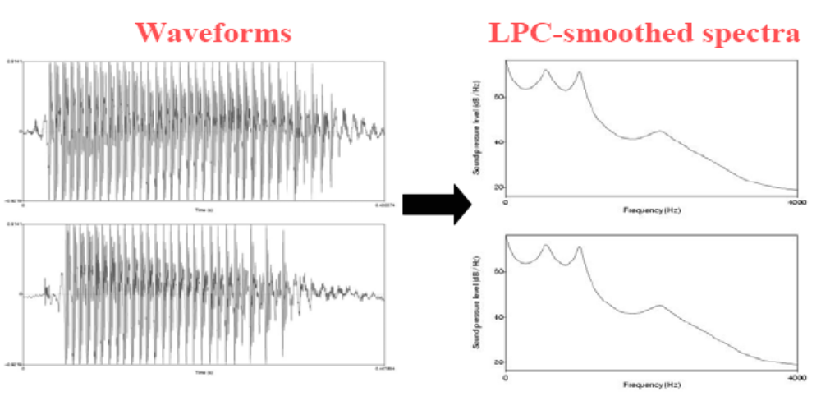
Why do we need feature extraction?
Acoustic speech signal varies over time. Can’t compare two waveforms
example: two instances of /a:/ vowel spoken in isolation, with time interval between repetitions < 1 second:

Slide 4
What is Features?
Feature = a measure of a property of the speech waveform
Reasons for feature extraction:
  Redundancy and harmful information is removed
  Reduced computation time
  Easier modeling of the feature distribution
Speech has many “natural” (Acoustic-phonetic) features:
  Fundamental frequency (F0), formant frequencies, formant bandwidths, spectral tilt, intensity, phone durations, articulation, etc
Not-so-natural features:
  Cepstrum, linear predictive coefficients, line spectral frequencies, vocal tract area function, delta and double-delta coefficients, etc

Slide 5
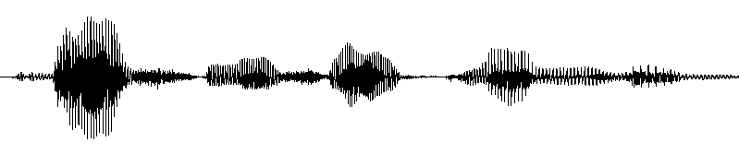
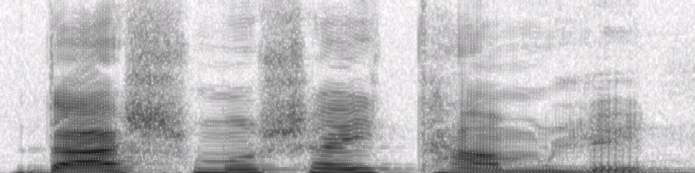
Segmental
d
ɐ
ʃ
m
o
ʃ
ɐ
j
tʰ
ɐ
m
l
e
n
Pitch profile #1
Pitch profile #2
Amplitude profile #1
Amplitude profile #2
Duration profile #1
Duration profile #2
Supra-Segmental

Slide 6
Speech Events
Segmental
Supra-segmental

Slide 7
Supra-segmental features and Prosody
Intonation, pause, duration, stress together are called prosodic or supra-segmental features and may be considered as the melody, rhythm, and emphasis of the speech at the perceptual level.
The prosody of a sentence is important for naturalness and for conveying the correct meaning of a sentence.

Slide 8
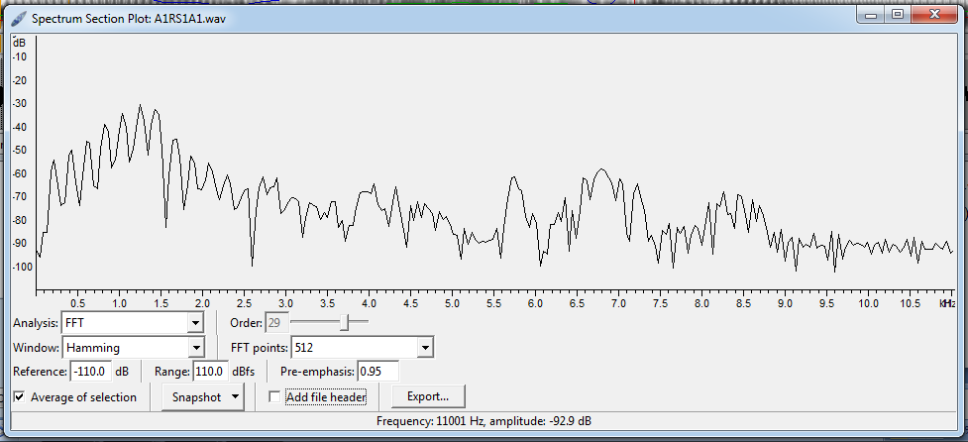
Peaks denote dominant frequency components in the speech signal
Peaks are referred to as formants
Formants carry the identity of the sound

Slide 9
Parameter / Feature Classification
Frequency Domain Parameters
Filter Bank Analysis
Short-term spectral analysis
Cepstral Transfer Coefficient (CC)
Formant Parameters
MFCC, Delta MFCC, Delta-Delta MFCC
Time Domain Parameters
LPC
Shape Parameters
Time- Frequency Domain Parameters
Perceptual Linear Prediction (PLP):
Wavelet Analysis

Slide 10
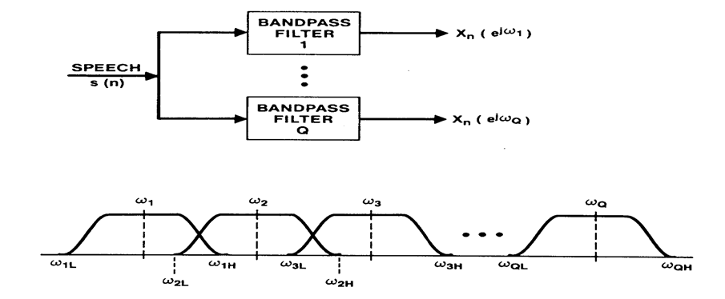
Filter Bank Analysis

Slide 11
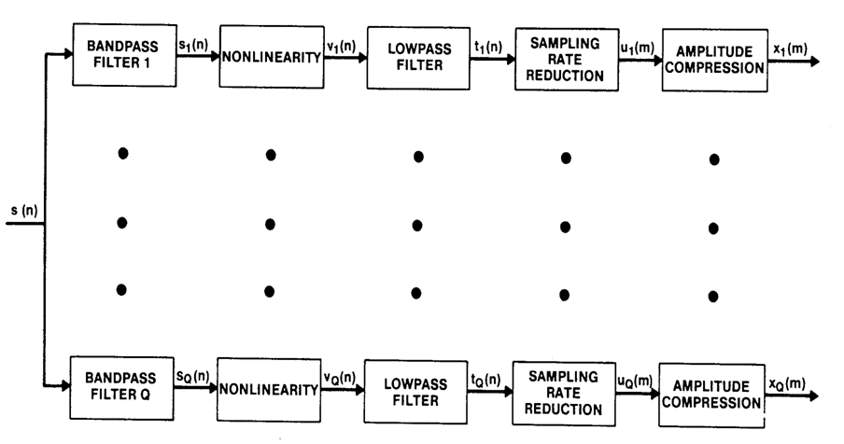
Complete Filter Bank Analysis Model

Slide 12
How to determine filter band ranges
  Uniform filter banks
  Log frequency banks
  Mel filter bands

Slide 13
Uniform Filter Banks
Uniform filter banks
  bandwidth B= Sampling Freq... (Fs)/no. of banks (N)
  For example Fs=10Kz, N=20 then B=500Hz
  Simple to implement but not too useful
V Filter output
v1
v2
v3
1
2
3
4
5
....
Q
...
freq..
500
1K
1.5K
2K
2.5K
3K
...
(Hz)

Slide 14
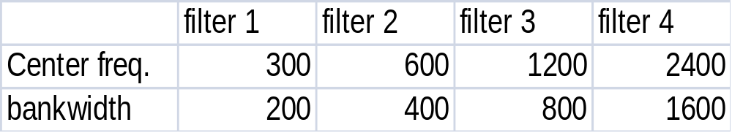
Non-uniform filter banks: Log frequency
Log. Freq... scale : close to human ear
V
Filter
output
v1
v2
v3
200
400
800
1600
3200
freq.. (Hz)

Slide 15
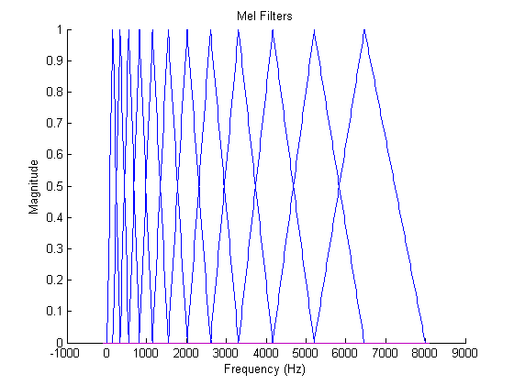
Mel filter bands
Freq. lower than 1 KHz has narrower bands (and in linear scale)
Higher frequencies have larger bands (and in log scale)
More filter below 1KHz
Less filters above 1KHz
Filter
output

Slide 16


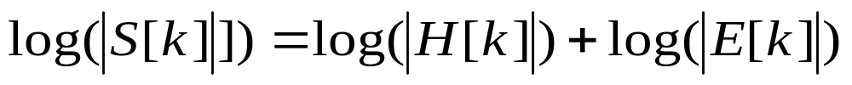
DFT of s[n]

Slide 17
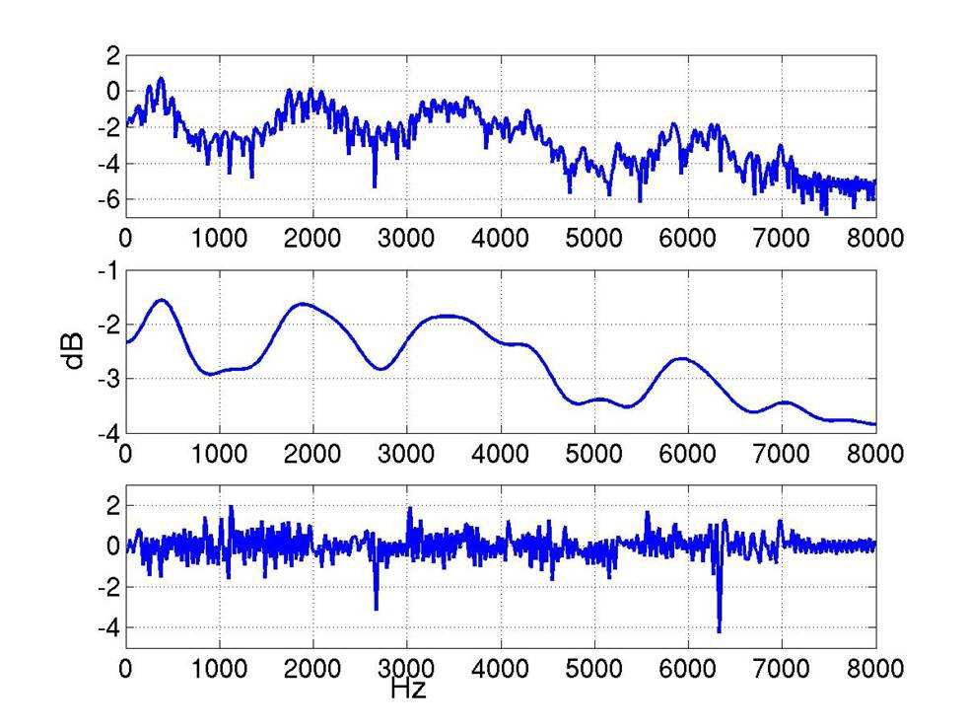
What we want to Extract? → Spectral Envelope
• Formants and a smooth curve connecting them
• This Smooth curve is referred to as spectral envelope

Slide 18

Cepstral analysis
Homomorphic speech processing
  Speech is modelled as the output of a linear, time varying system (linear time-invariant (LTI) in short seg.) excited by either quasi-periodic pulses or random noise.
  The problem of speech analysis is to estimate the parameters of the speech model and to measure their variations with time.
  Since the excitation and impulse response of a LTI system are combined in a convolutional manner, the problem of speech analysis can also been viewed as a problem in separating the components of a convolution, called ”deconvolution”.

Slide 19
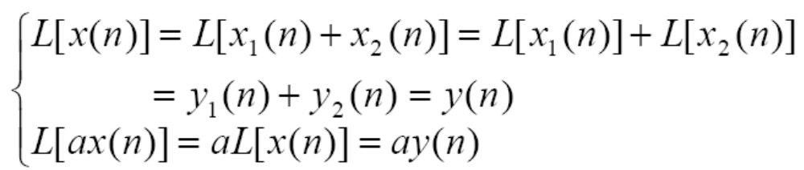
The principle of superposition for conventional linear systems:
If signals fall in non-overlapping frequency bands then they are separable
  x[n]=x₁[n]+x₂[n]
  X₁(ω)=ℱ{x₁[n]} & X₁(ω) [0, π/2],
  X₂(ω)=ℱ{x₂[n]} & X₂(ω) [π/2, π],

Slide 20
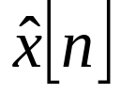
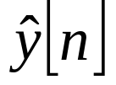
Principles of Homomorphic Processing
Importance of homomorphic systems for speech processing lies in their capability of transforming nonlinearly combined signals to additively combined signals so that linear filtering can be performed on them.
Homomorphic systems can be expressed as a cascade of three homomorphic sub-systems → referred to as the canonic representation:
H
*
+
+
+
+
-1
*
x[n]
D*
L
D*
y[n]
I
II
III
Notes:
Digital Systems: Hardware Organization and Design
Architecture of a Respresentative 32 Bit Processor

Slide 21
Canonic Representation of a Homomorphic System
I
*
+
x[n]
D*
System takes inputs combined by convolution and transforms them into additive outputs
System is a conventional linear system
Inverse of first system--takes additive inputs and transforms them into convolution outputs
II
+
+
L
III
+
-1
*
D○
y[n]
Notes:
Digital Systems: Hardware Organization and Design
Architecture of a Respresentative 32 Bit Processor

Slide 22
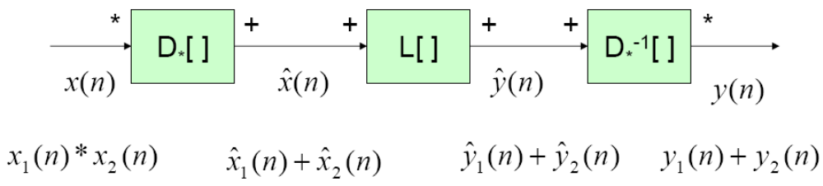
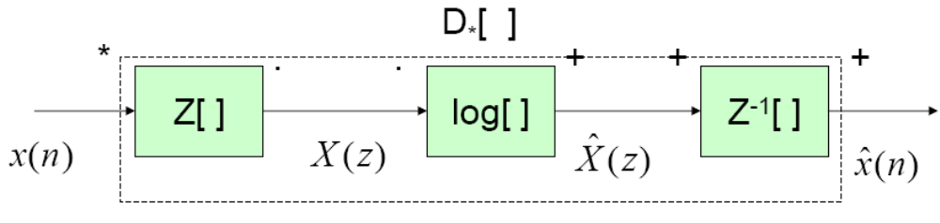
Cepstral analysis
Canonic form for system for homomorphic deconvolution
The characteristic system for homomorphic deconvolution

Slide 23

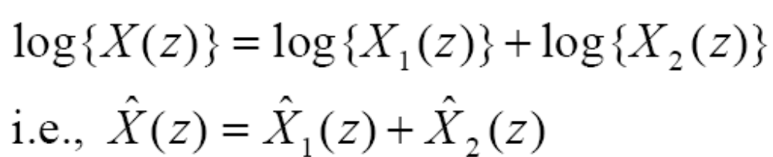

Cepstral analysis
Observation:
taking logarithm of X(z), then
in the cepstral domain
So, the two convolved signals are additive in the cepstral domain

Slide 24
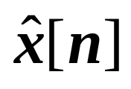
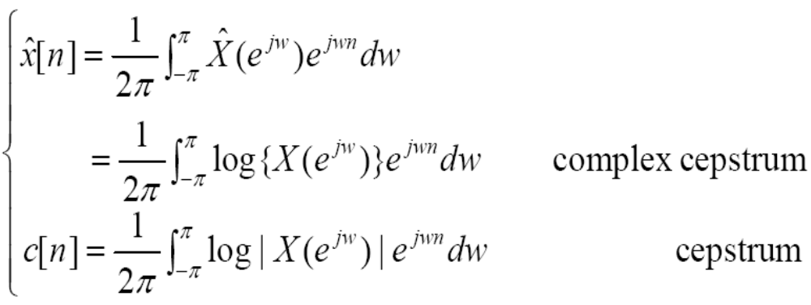
Cepstral analysis
Real cepstrum c[n] is the even part of

Slide 25
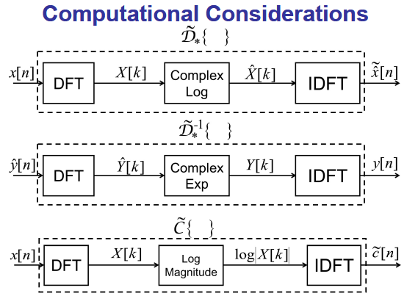

Slide 26
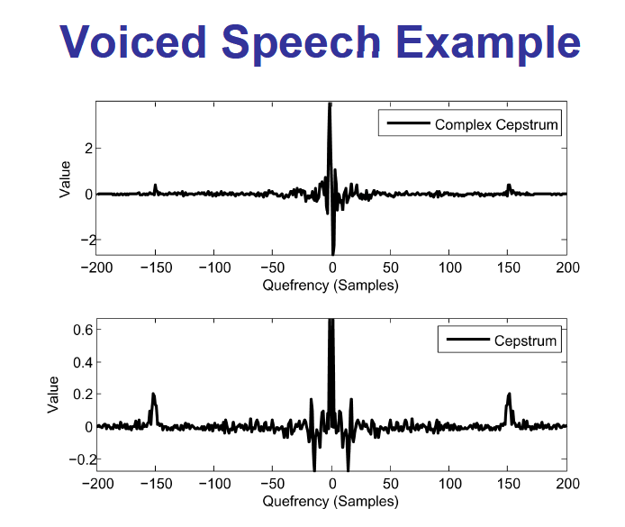

Slide 27
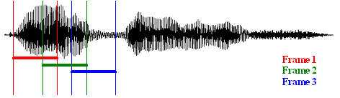

Basic Speech processing steps for Frequency Parameter
Signal: S(t) = x[n]
Basic
Signal
Processing
Block
y[n] = x[n] – α * x[n-1] (where α = 0.95)
Pre-emphasis
Framing
Windowing
x(n) = x(n)*W(n)
Hamming : 0.54 – 0.46 cos(2*pi*n/(N-1))
Hanning : 0.5(1- cos(2*pi*n/(N-1)))
Cosine : sin(pi*n/(N-1))
DFT
Power Spectrum

Slide 28
Cepstral Transform Coefficients (CC)
Basic
Signal
Processing
Block
Speech
Log
IDFT
Cepstrum

Slide 29
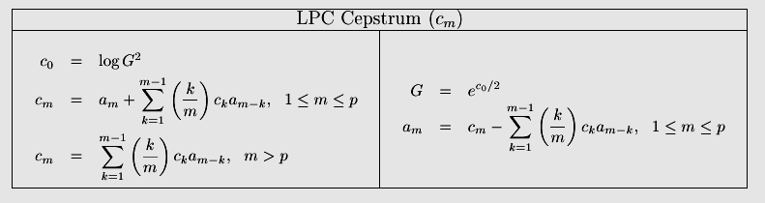
LPC Cepstrum
The LPC vector is defined by [a₀,a₁,a₂,...a_{p}] and the CC vector is defined by [c₀c₁c₂...c_{p}...c_{n−1}

Slide 30
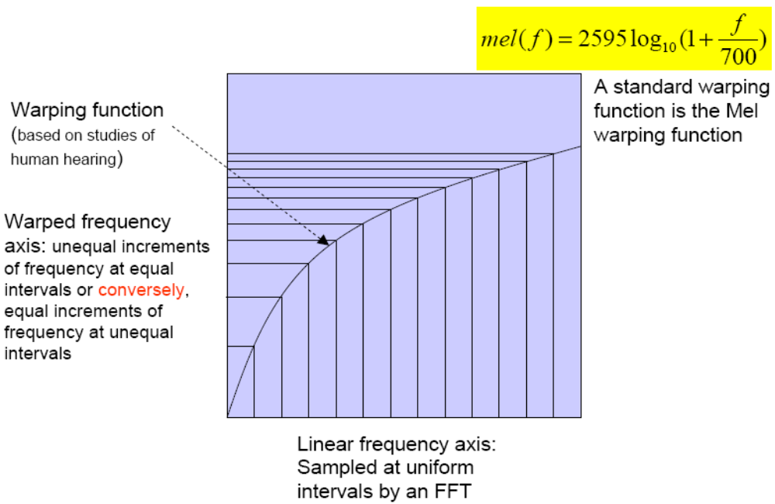
Warping frequency warping

Slide 31
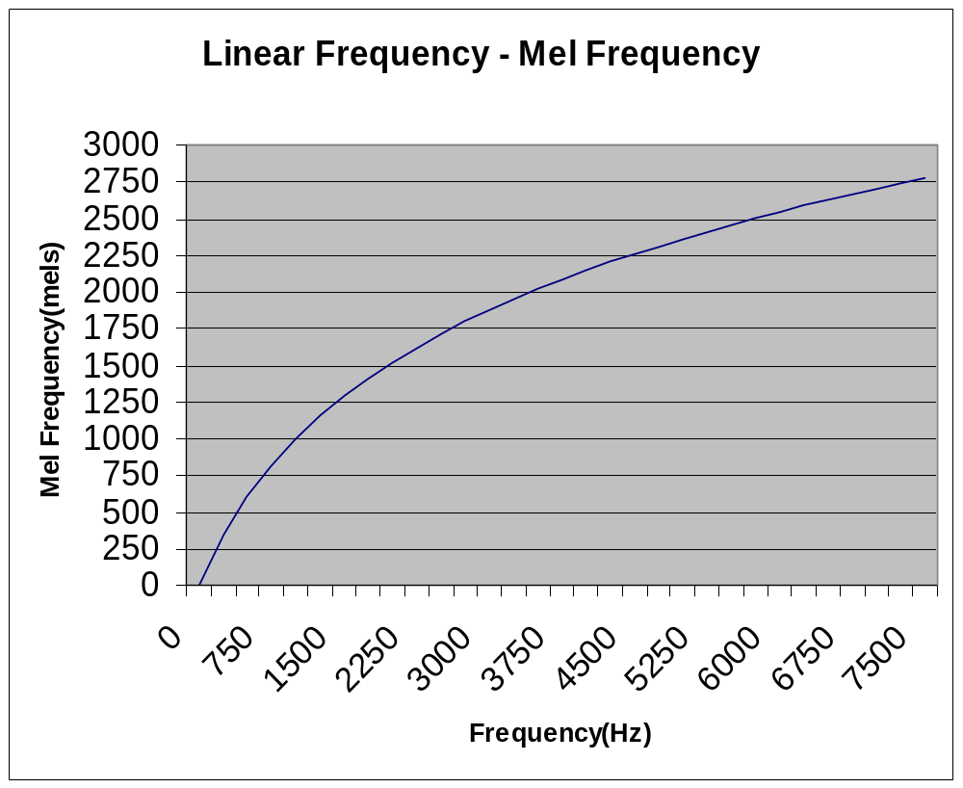

Slide 32
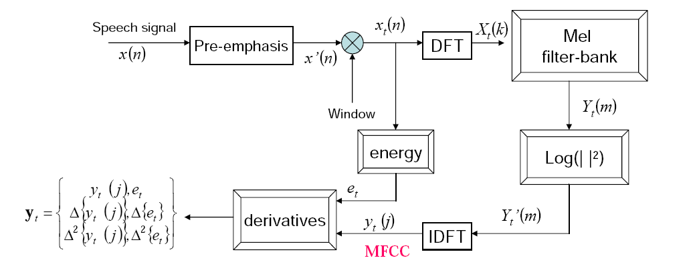
MFCC

Slide 33
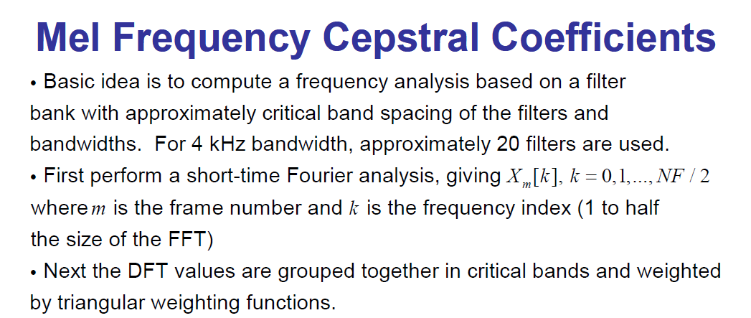
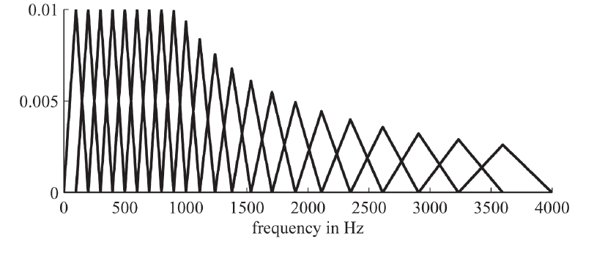

Slide 34
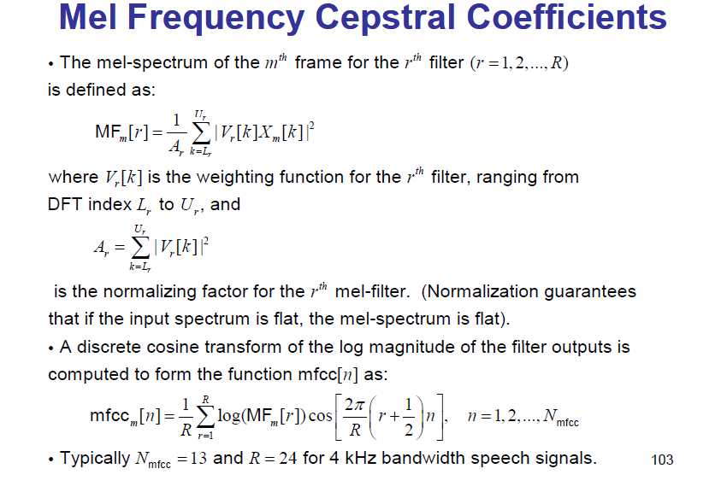

Slide 35
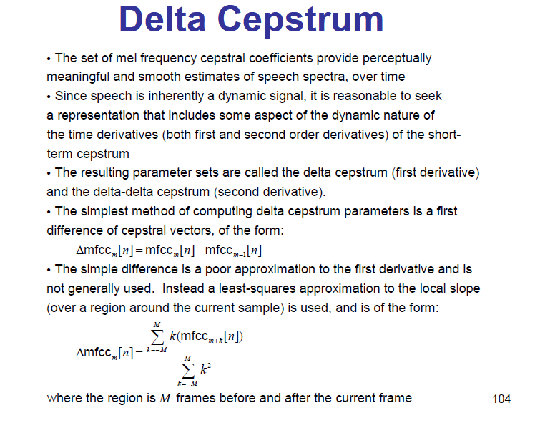
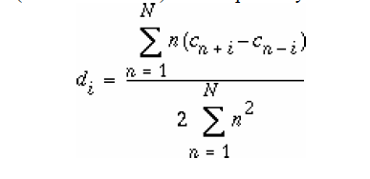

Slide 36
Perceptual Linear Prediction
PLP parameters are the coefficients that result from standard all-pole modeling or linear predictive analysis, of a specially modified, short-term speech spectrum.
In PLP the speech spectrum is modified by a set of transformations that are based on models of the human auditory system
The spectral resolution of human hearing is roughly linear up to 800 or 1000Hz, but it decreases with increasing frequency above this linear range

Slide 37
Perceptually motivated analyses
Critical-band spectral resolution: PLP incorporates critical-band spectral-resolution into its spectrum estimate by remapping the frequency axis to the Bark scale and integrating the energy in the critical bands to produce a critical-band spectrum approximation.
Equal-loudness pre-emphasis: At conversational speech levels, human hearing is more sensitive to the middle frequency range of the audible spectrum. PLP incorporates the effect of this phenomenon by multiplying the critical-band spectrum by an equal loudness curve that suppresses both the low- and high-frequency regions relative to the midrange from 400 to 1200 Hz.
Intensity-loudness power law: There is a nonlinear relationship between the intensity of sound and the perceived loudness. PLP approximates the power-law of hearing by using a cube-root amplitude compression of the loudness-equalized critical band spectrum estimate.

Slide 38
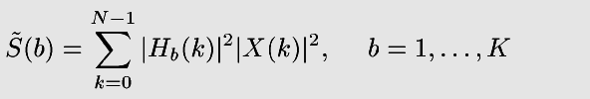
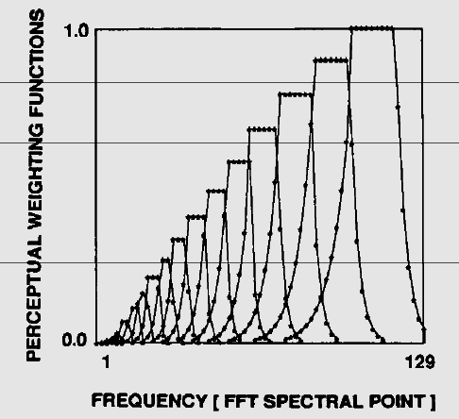
Perceptual LPC
(Hermansky, J. Acoust. Soc. Am., 1990)
First, warp the spectrum to a Bark scale:
The filters, H_{b}(k), are uniformly spaced in Bark frequency. Their amplitudes are scaled by the equal-loudness contour (an estimate of how loud each frequency sounds):

Slide 39
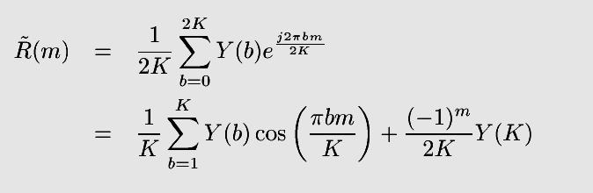
Perceptual LPC
Second, compute the cube-root of the power spectrum
  Cube root replaces the logarithm that would be used in MFCC
  Loudness of a tone is proportional to cube root of its power
Y(b) = S(b)^{0.33}
Third, inverse Fourier transform to find the “Perceptual Autocorrelation:”

Slide 40

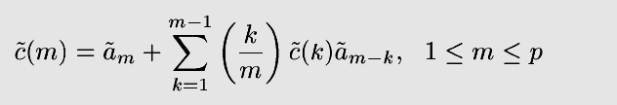
Perceptual LPC
Fourth, use Normal Equations to find the Perceptual LPC (PLP) coefficients:
Fifth, use the LPC Cepstral recursion to find Perceptual LPC Cepstrum (PLPCC):

Slide 41
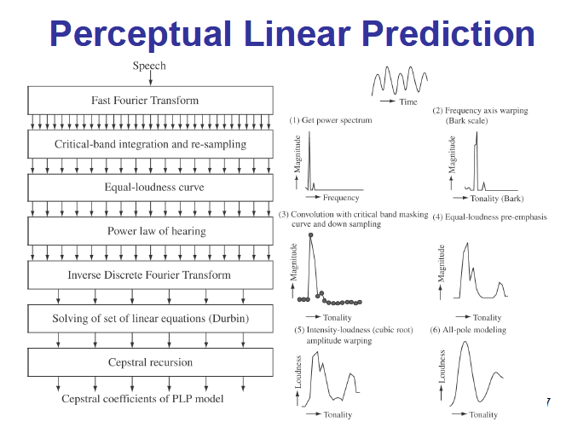

Slide 42
RASTA(RelAtive SpecTrA )
The rate of change of nonlinguistic components of speech and background noise environments often lies outside the typical rate-of-change of vocal-tract shapes in conversational speech
Hearing is relatively insensitive to slowly varying stimuli
The basic idea of RASTA filtering is to exploit these phenomena by suppressing constant and slowly varying elements in each spectral component of the short term auditory-like spectrum prior to computation of the linear prediction coefficients

Slide 43
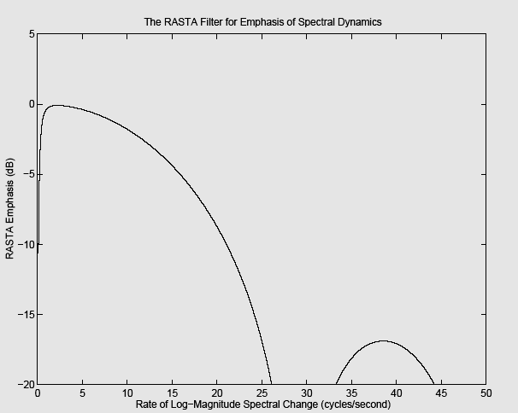

RASTA (RelAtive SpecTral Amplitude)
(Hermansky, IEEE Trans. Speech and Audio Proc., 1994)
Modulation-filtering of the cepstrum is equivalent to modulation-filtering of the log spectrum:
c_{t}*[m] = Σ_{k} h_{k} c_{t-k}[m]
RASTA is a particular kind of modulation filter:

